Slide 1
BlockChain ATM
Agenda:
Current Cross Bank ATM Network vs Future Blockchain Network
Innovation Values
System Architecture
Transaction Demonstration
Innovation Essentials
System Features, Environments, Technologies, and Tools
Roadmap

Slide 2
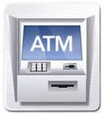

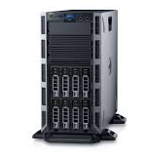






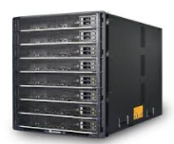

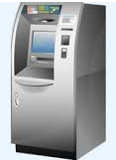
Current Cross Bank ATM Network vs Future Blockchain Network
……

Slide 3
Innovation Values
- Data processing revenues, and international transaction revenues
Millions USD

Slide 4


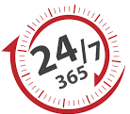


Innovation Values
3rd party association cost saved, pure bank-to-bank communication (90% surcharge per transaction can be saved)
No customer information exchange with 3rd party, all customer information protected in bank
No server down time, real 7 X 24
Never can transaction record be changed
No fake transaction can be accepted in BlockChain, even hackers attempt to
The architecture can be easily extended to other inter-bank system, e.g., transfer, payment, capital exchange etc.

Slide 5
System Architecture
Bank A
Blockchain
Bank C
Bank B

Slide 6

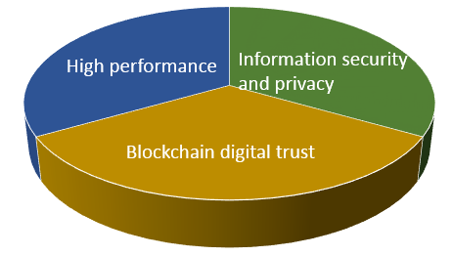










Innovation Essentials and Technologies
Blockchain to provide digital trust: - Cross bank transaction routing and clearing
Information security and privacy: - Network permissioning - Encrypted customer information unreadable in blockchain
High performance: - Raft-based Consensus to ensure millisecond-level blocktimes
Other technologies and environments:
Visit our public GitHub: https://github.com/yifon/SST_BlockChain

Slide 7
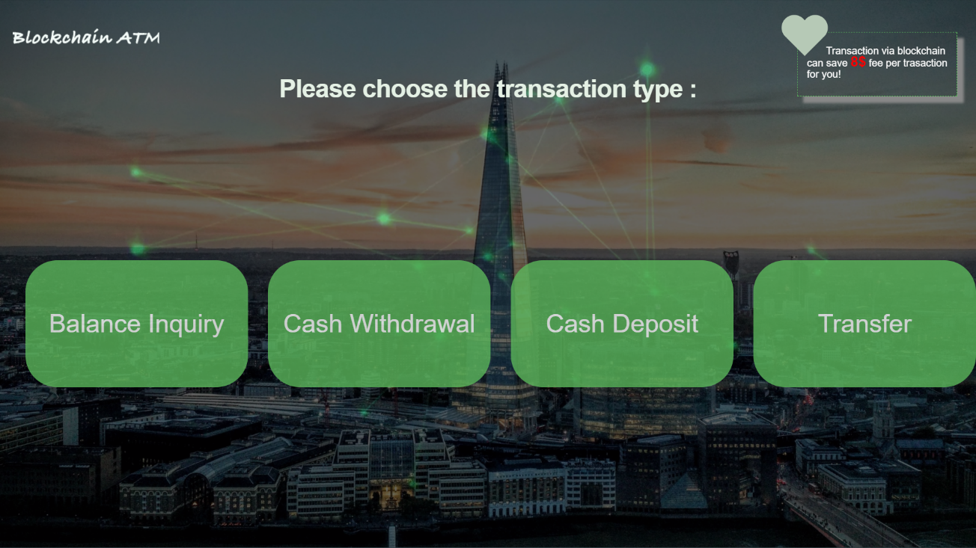
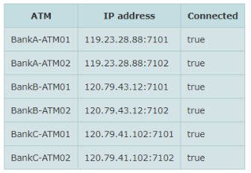
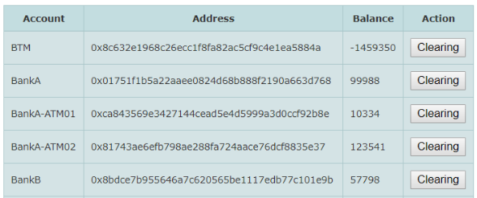
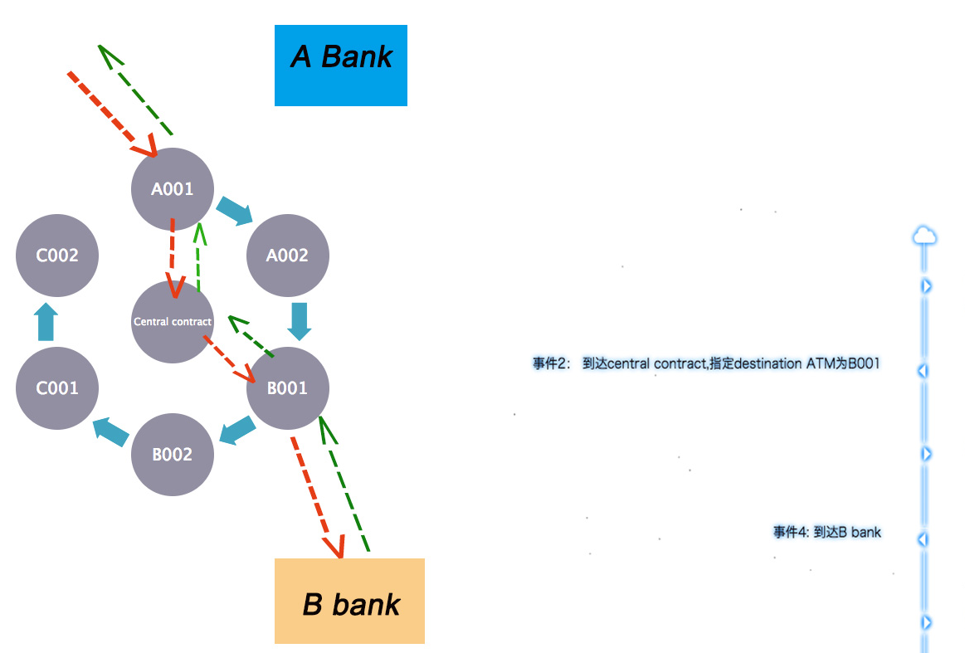
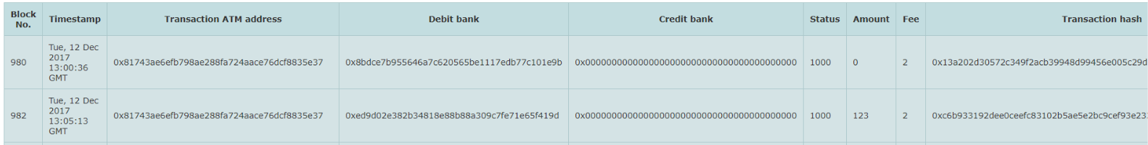
Our prototypes
Balance enquiry / cash withdrawal / deposit / transfer transactions
Blockchain network status, account balance and transaction records
Bank transaction records

Slide 8
Roadmap
Different entities,
same group,
Cross countries
Different entities,
same group,
same country
Different banks,
Cross countries
Different banks in limited areas,
Same country

